Slide 1
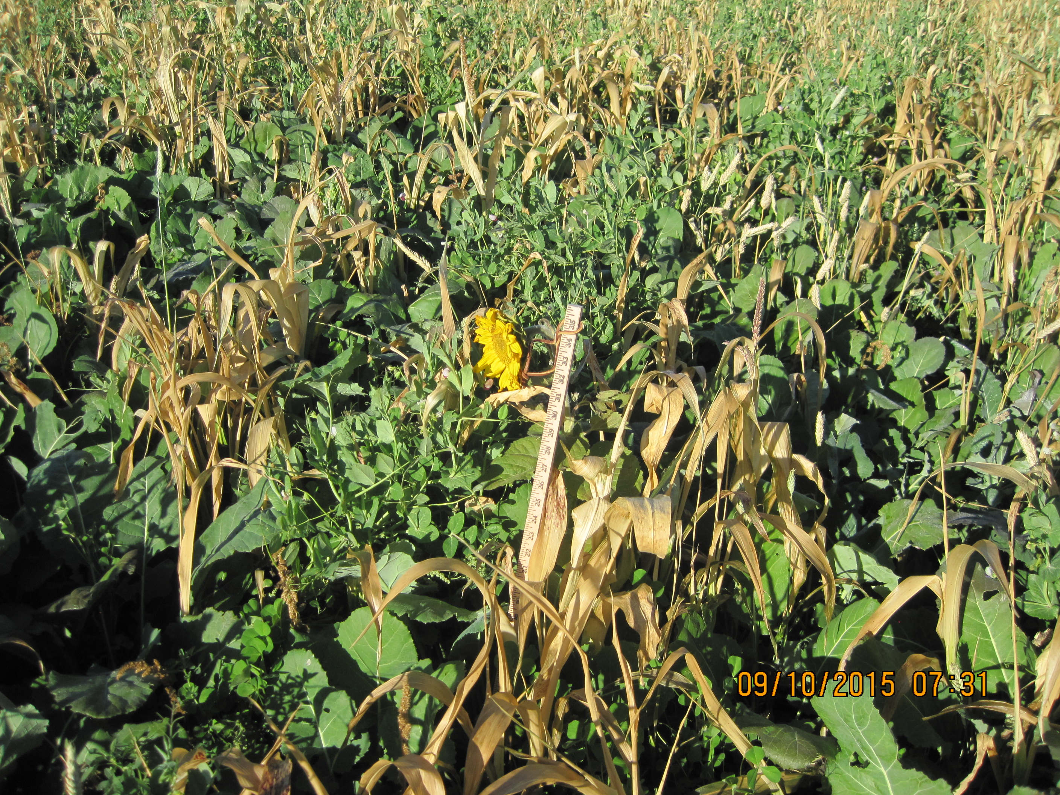
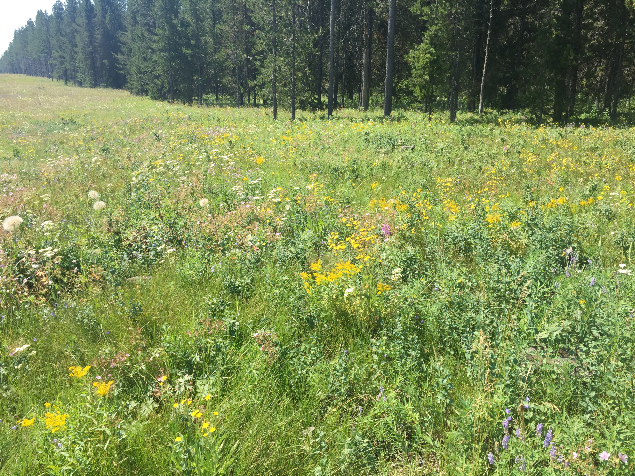
Module 5 Principle of Maximize Diversity and Cover Crop Functional Groups
Photos: M. Winger

Slide 2
Learning Goal
To introduce the concept of diversity and how it applies to cover crop management. They will learn:
  What ecological theories under pin current recommendations
  How organisms are different from an agricultural perspective
  Common cover crop functional groups

Slide 3
Learning Checks
  Why diversity is important ?
  Name common benefits and challenges of grasses, legumes, and brassicas.
  Explain how we can apply these concepts when incorporating a cover crop into a cropping system.

Slide 4
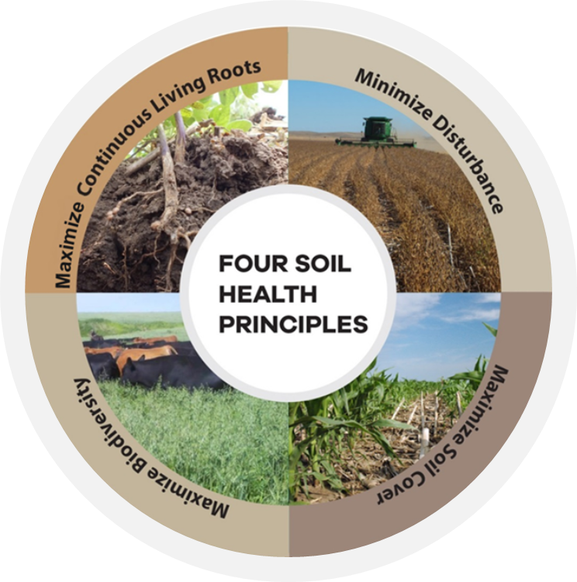

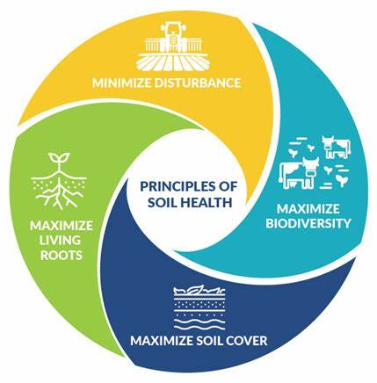
Soil Health Principle Maximize Biodiversity

Slide 5
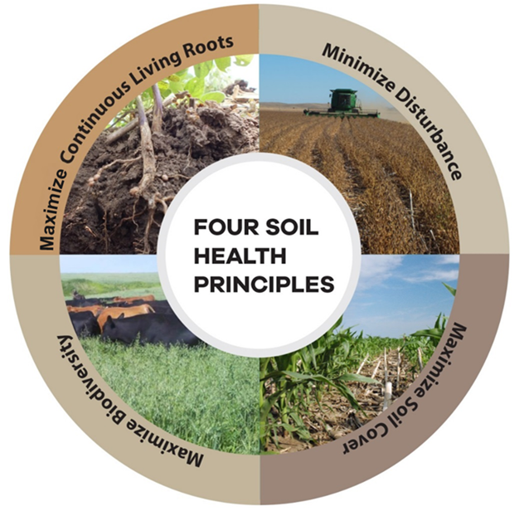
Maximizing Biodiversity
SOIL HEALTH PRINCIPLES
Notes:
The four soil health principles being advocated by NRCS are essentially attempting to mimic what is typically occurring in native ecosystems.
Minimizing soil disturbance, whether that is physical (tillage), chemical (excessive nutrients or pesticides) or biological (creating favorable conditions for diseases or weeds). Recognize that some, managed disturbance may be desirable. That should be managed to a minimum that meets the management objectives.
Maximize cover of the soil with living or dead plant material.
Maximize the diversity of the system. Fundamentally, this will be introducing greater temporal and spatial diversity with plants. Adding grazing animals to the cropping system would be another means of increasing diversity in the system.
Maximize the time and distribution of living roots in the soil. This will be in large part dependent on climate and cropping system. Understand that the goal is have growing plants for as much of the year as practicable.

Slide 6
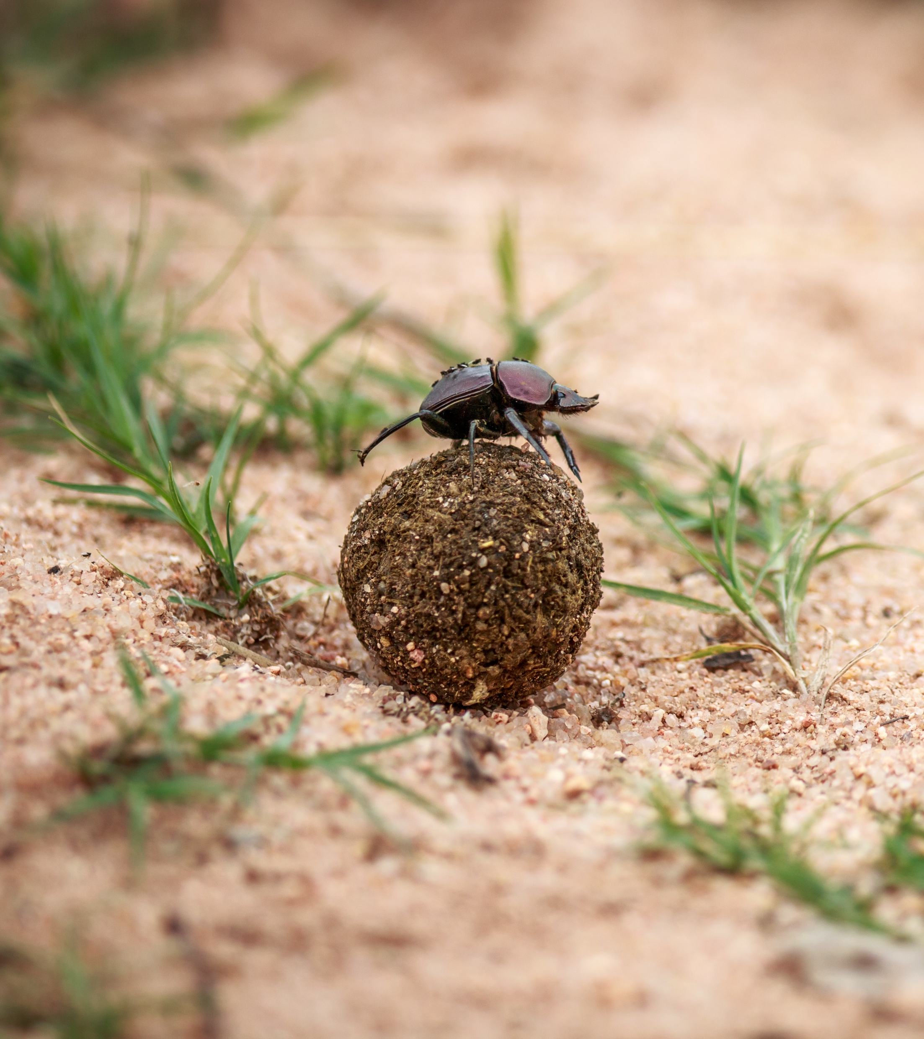
Biodiversity
What is it?
The amount of variation of organisms in an ecosystem.
Why is it important?
It can improve
Plant productivity
Invasion resistance
Water use and retention
Nutrient cycling and storage
Stability/resiliency – redundant systems
Promotes diversified biology

Slide 7

How does it work?

Slide 8





Organism Diversity
Each organism fills a different niche in the ecosystem. They would have different:
Life cycles (birth to death)
Environmental requirements or tolerances
Nutrient requirements
Nutrient acquisition strategies (enzymes, acids, roots, AMF, shredding, rhizophagy)
Pest & disease resistance - communication
Plant leaf and root architecture
Notes:
Can we add some real micro pictures

Slide 9
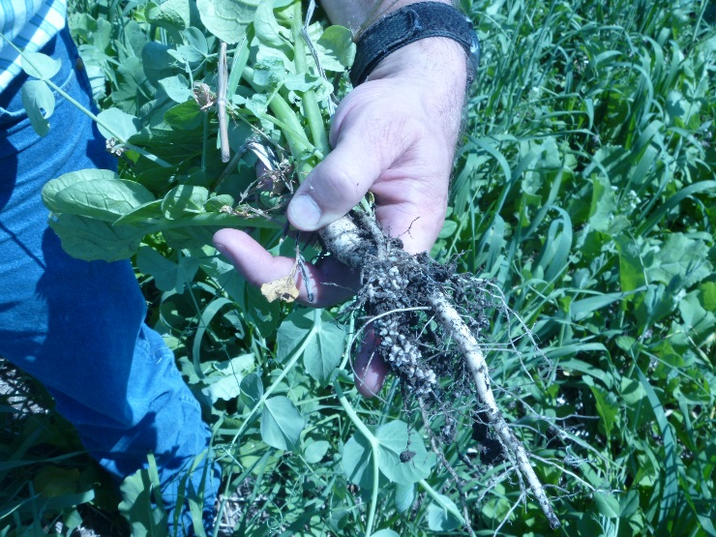
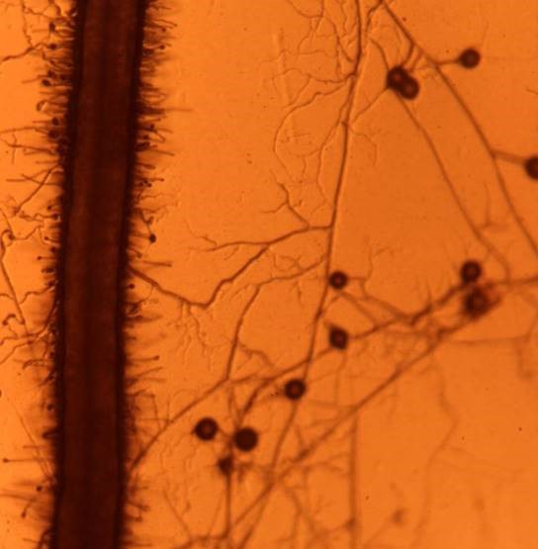
Functional Redundancy
Many organisms can fill the same role in their environment
Example:
Nitrogen availability in ecosystem functionality
Legumes fixing Nitrogen
Free living (N) fixing organisms
Cereals & Broadleaf plants scavenging Nitrogen
Example:
Phosphorus availability in soil can be increased by
P solubilizing bacteria
P scavenging fungi (AMF)
Pea & Radish
Photo: M. Winger
Carrot root on left, AMF with spores
Photo: Z. Kabir
Notes:
In ecology, functional equivalence (or functional redundancy) is the ecological phenomenon that multiple species representing a variety of taxonomic groups can share similar, if not identical, roles in ecosystem functionality (e.g., nitrogen fixers, algae scrapers, scavengers).^{[1]} Hubbell, Stephen P. (2005-01-01). "Neutral Theory in Community Ecology and the Hypothesis of Functional Equivalence". Functional Ecology. 19 (1): 166–172. doi:10.1111/j.0269-8463.2005.00965.x. JSTOR 3599285.
Humans are drastically altering the composition of ecological communities globally (Dornelas et al. 2014, Elahi et al. 2015), which has cascading impacts on associated ecological functions and services (Cardinale et al. 2012). In particular, increasing rates of species extinctions associated with human impacts have caused intense interest in the implications of this biodiversity loss on ecological processes (Ceballos et al. 2015). The relationship between species richness and overall ecosystem function has been studied extensively (Loreau et al. 2001, Cardinale et al. 2006, van der Plas 2019); it is generally held that greater species richness leads to increases in overall ecosystem function, such as biogeochemical activities, the transfer of energy, ecological services, and production of biomass, either through niche complementarity or sampling effects (Loreau and Hector 2001). The degree to which the loss of an individual species impacts overall ecosystem structure and function, however, depends on whether there are other species within the community that perform similar ecosystem functions, a property commonly referred to as functional redundancy (Walker 1992, Naeem 1998).

Slide 10
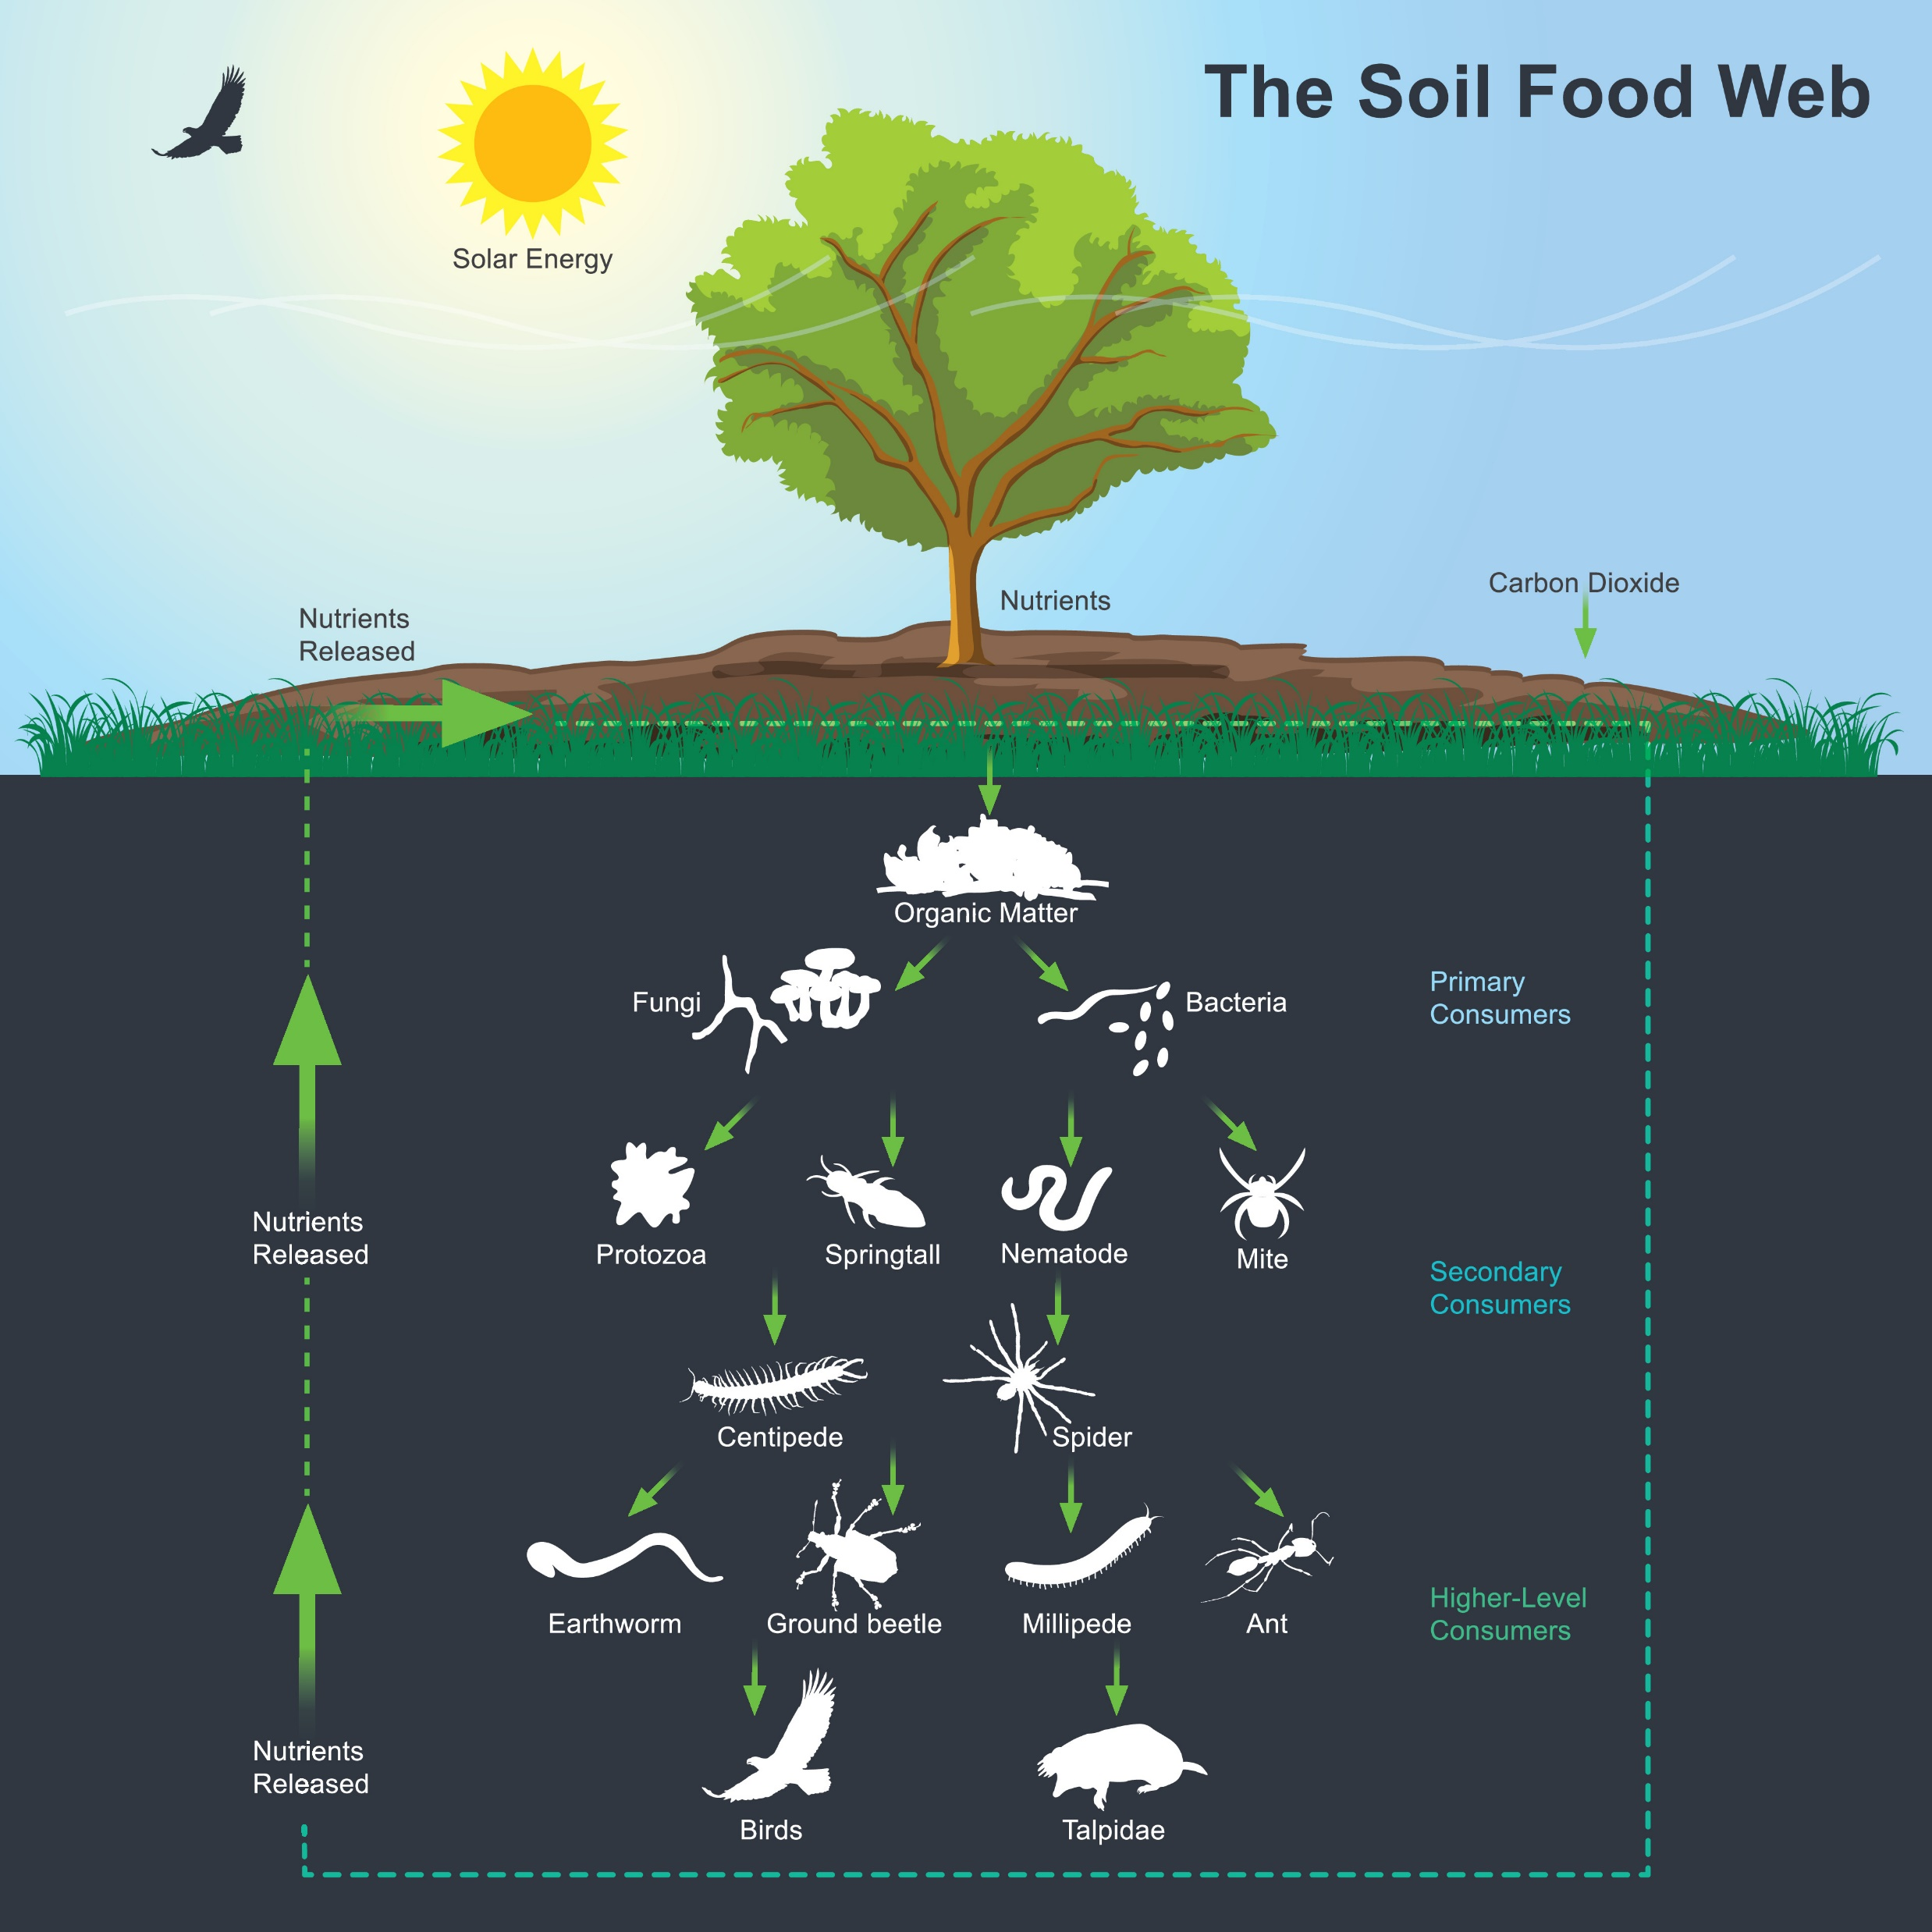
Organism Diversity in the Soil Food Web
If you implement the Soil Health principles, you can regenerate diverse organisms.
Notes:
Look in soil biology primer

Slide 11
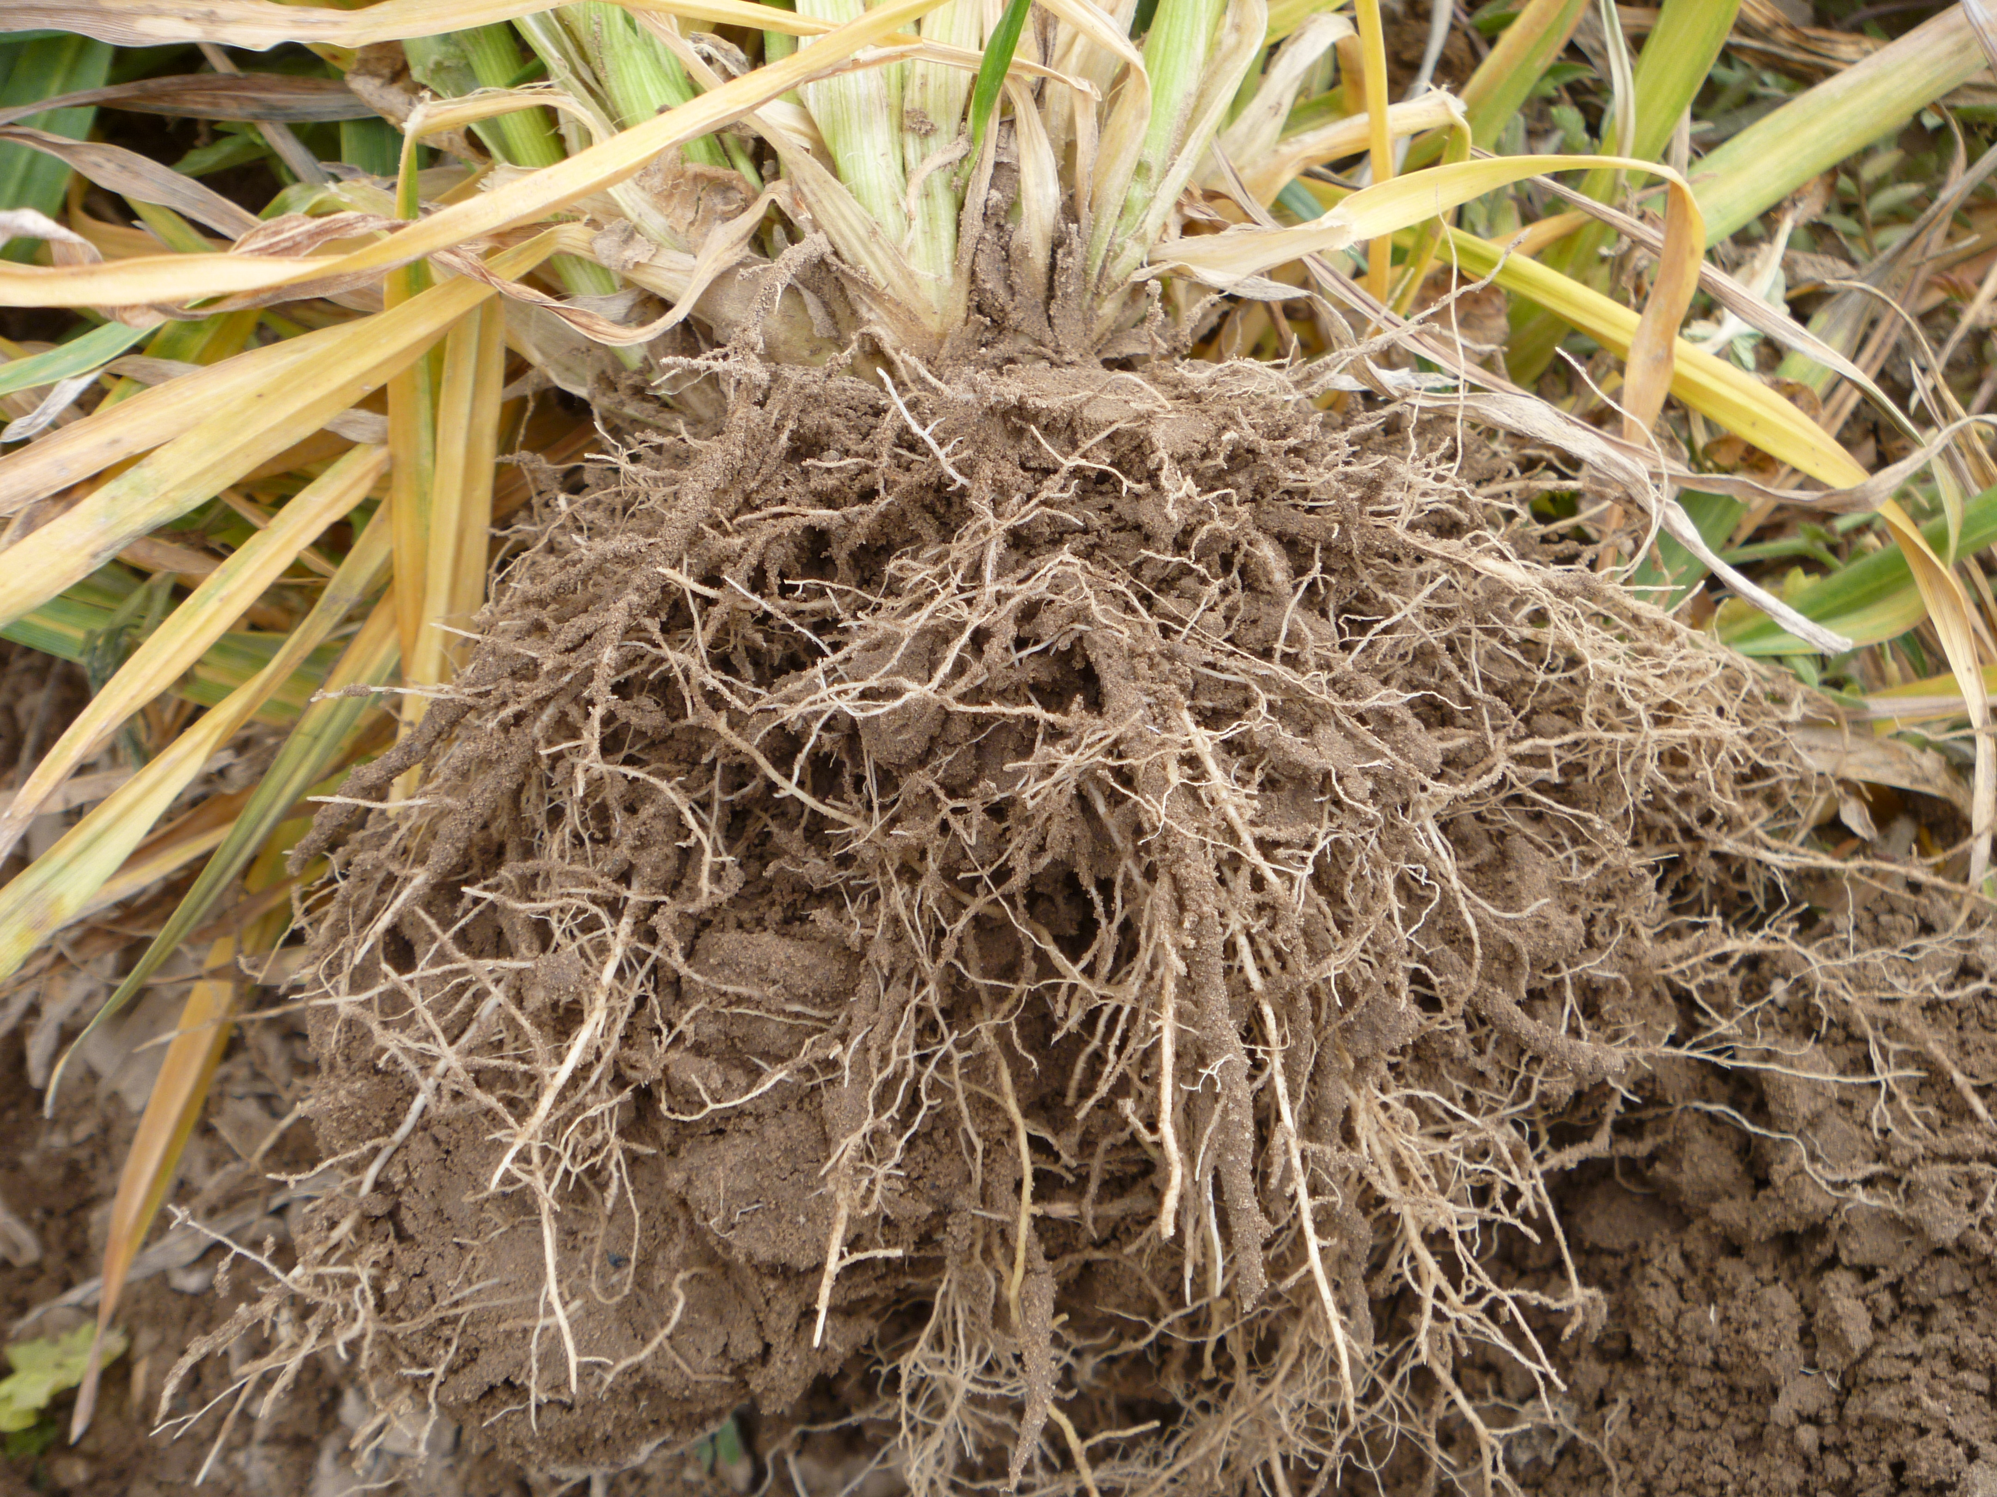
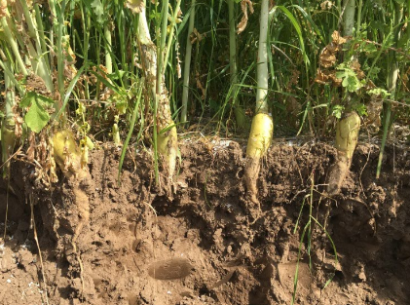
Example of Physiological Diversity
Fibrous wheat roots, Photo: M. Winger
Radish tap roots, Photo: Z. Kabir
Notes:
Read these notes:
How are these plants different?
Above ground leaf and root architecture
Water use and storage strategies
Chemical weapons: allelopathy, polyphenols
Based on their form – what role do you think they fill in their ecosystem?

Slide 12
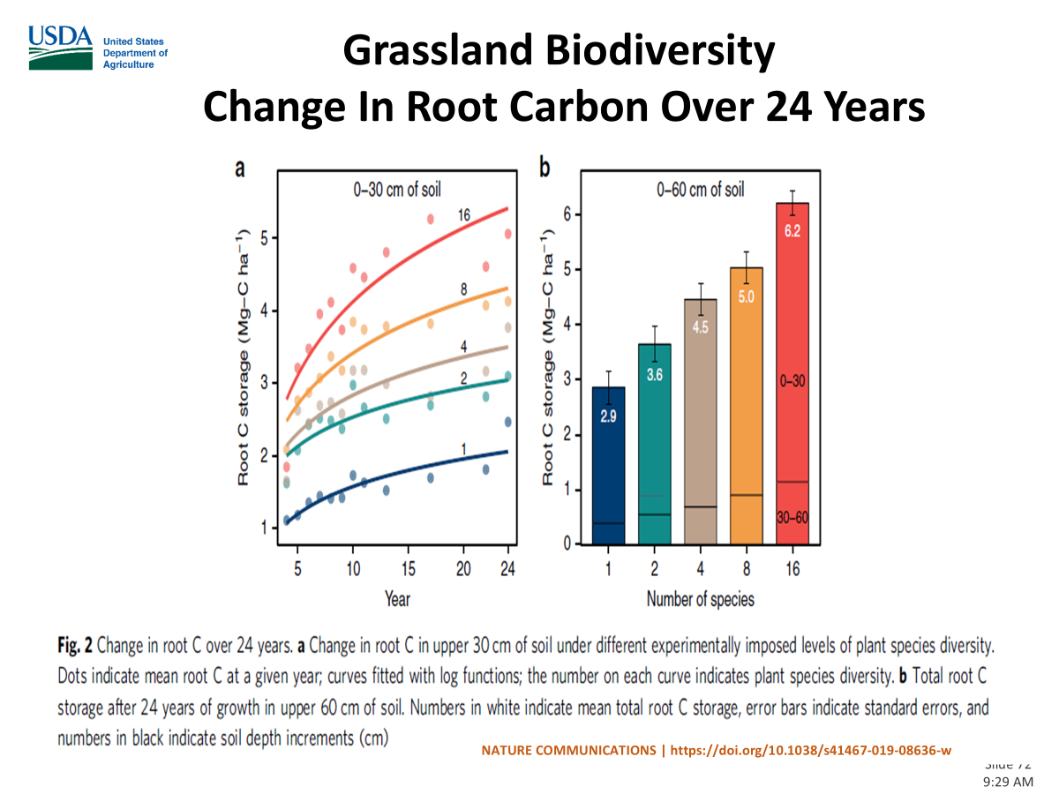

Slide 13
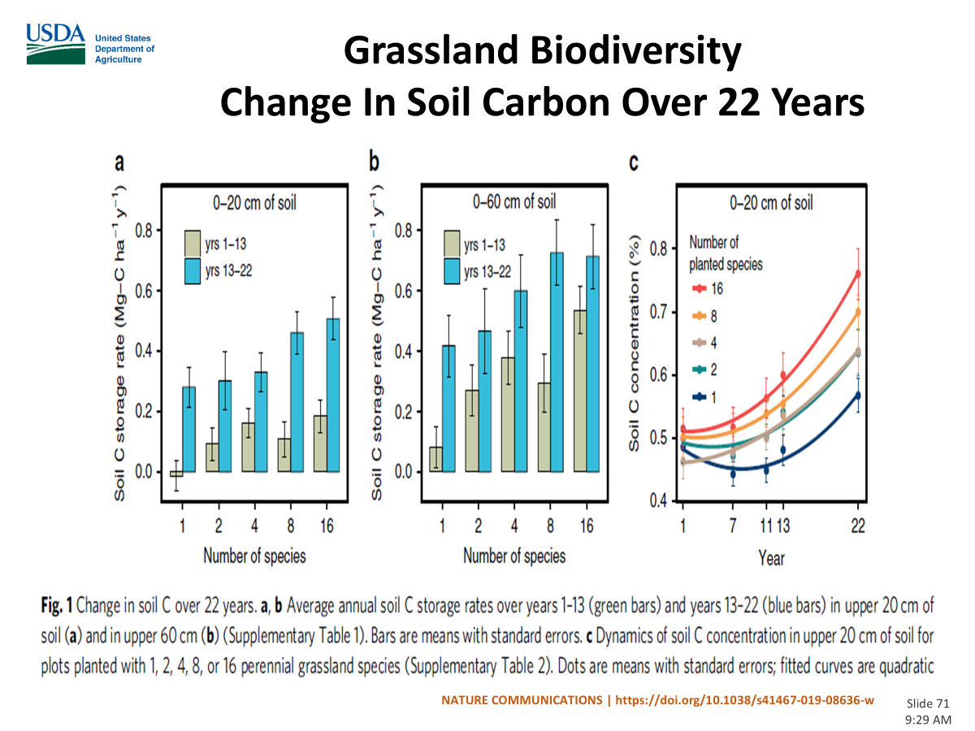

Slide 14
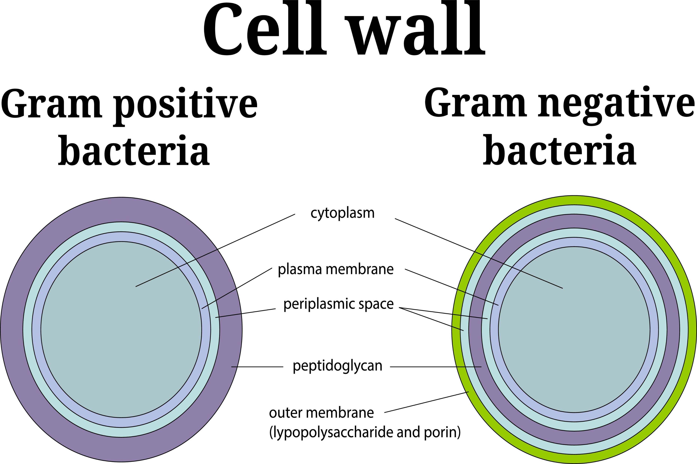
Example of Physiological Diversity
Aerobic conditions
Anerobic conditions

Slide 15
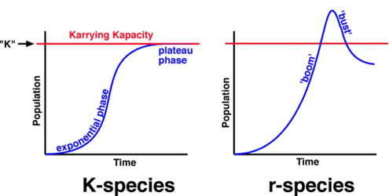
Diversity in Growth Strategies
Notes:
r= rapid strategists type of bacteria- after disturbance these type of bacteria they grow exponentially
K= strategists, Implementing SH principles will foster more K type bacteria
Page 533 nature and properties of soils 15th edition
In healthy systems you have more K species. In high disturbance systems you have r species

Slide 16
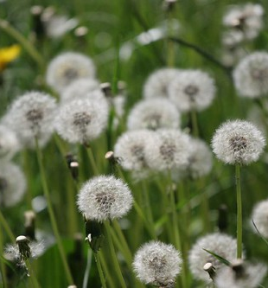
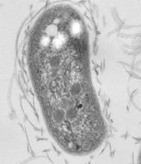
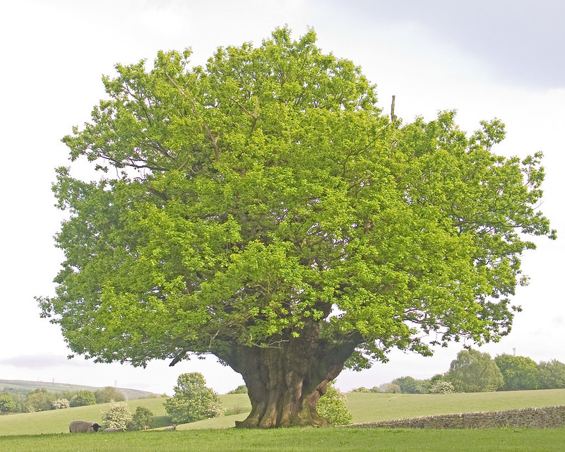
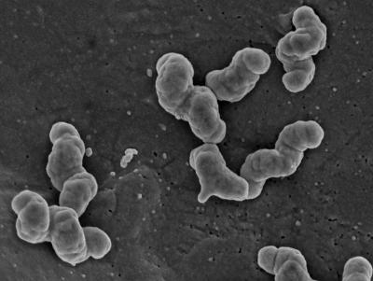
Growth Strategies
r-selected species
Favors unstable environments
Responds quickly to resources
Poor competitor
Pathogenic organisms
K-selected species
Favors stable environment
Responds slowly to resources
Good competitor
Beneficial organisms
"The old oak tree at Towneley" by Chas. Townley is licensed under CC BY-SA 2.0.
Nitrospira at 70,000x magnification by Boris Nowka and Eva Spieck, University of Hamburg
"Dandilions" by Twix is licensed under CC BY-SA 2.0.
"File:TEM Image of Nitrobacter winogradskyi str. Nb-255.jpg" by Professor William Hickey is licensed under CC BY-SA 2.0.
Notes:
Both bacteria oxidize nitrite in their environment but have different strategies
Reproduction r= many offspring, k = few offspring
Growth: r= grow quickly, K = grow slowly
Environment: r = live in unstable environment (high disturbance), K= stable environments
Care for offspring: r= provide little to no care, K = lots of care for offspring
AMF = k species
Pathogenic fungus = r strategies
Page 533 NP of soils

Slide 17
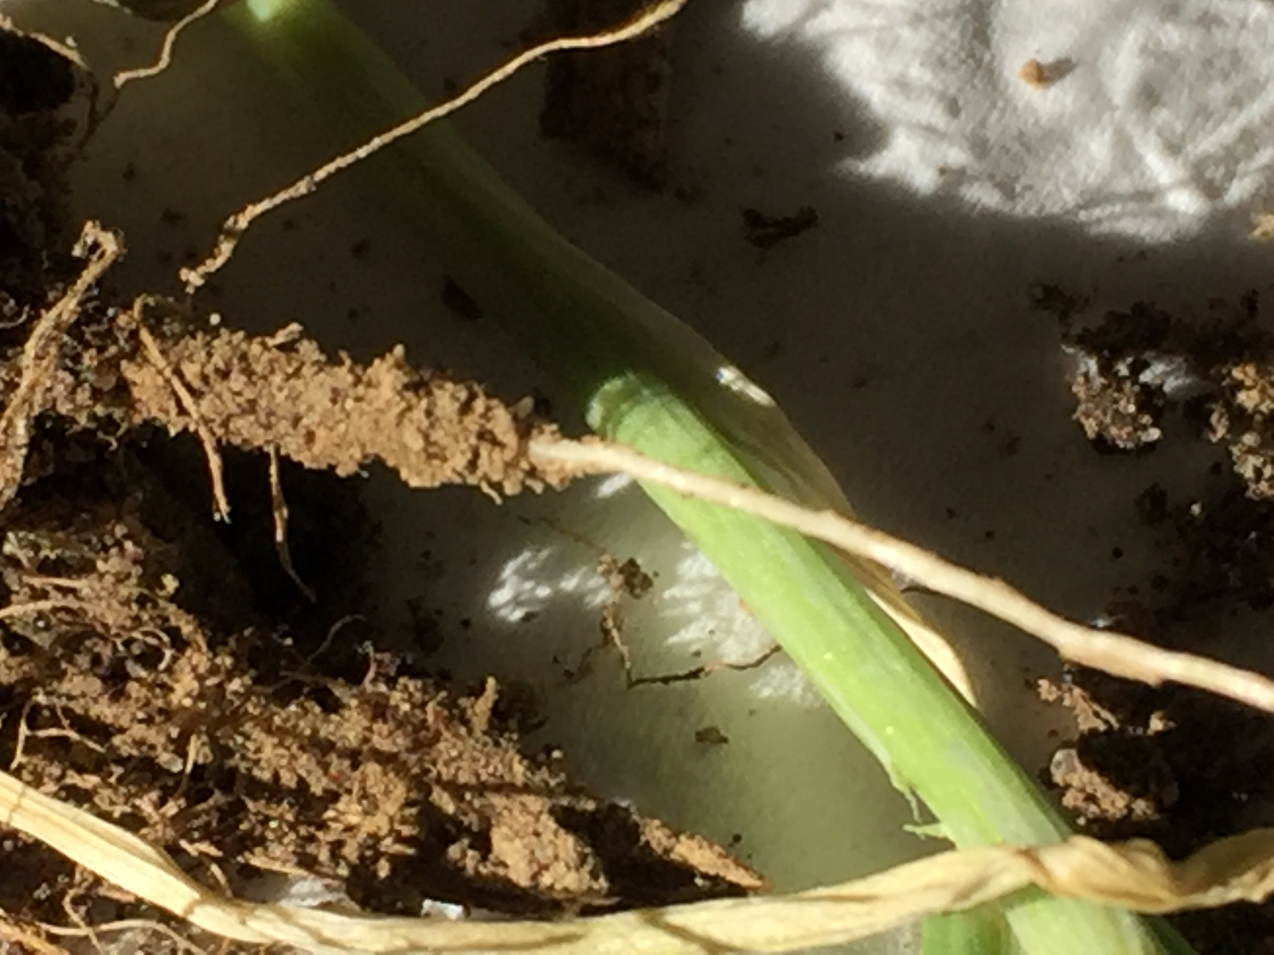
In a healthy, diverse community, there is balance, food supply, habitat (aggregate), predator / prey relationships, competition for resources and no wasted resources.
Organism Diversity
Oat root showing vigorous rhizosphere. Photo: M. Winger
Notes:
In a healthy, diverse community there is balance, food supply, habitat (aggregate), predator /prey relationships competition for resources, and no waited resources

Slide 18
Ecological hypotheses that relate to agricultural management
Diversity-stability hypothesis/insurance hypothesis
Because species have various responses to the environment (cold & wet vs hot & dry) and resource availability, it is more likely that the cover crop will establish itself despite climatic / weather variation.
Diverse cover crop mixes will help small seedling emerge and establishment.
Diverse mixes will encourage multiple benefits such as, pollinators, beneficial insects, compaction relief of both shallow and deep levels, N fixation, AMF association, signaling.

Slide 19
Ecological hypotheses that relate to agricultural management
Diversity-nutrient retention hypothesis
Diverse plant communities will be more efficient at taking up available nutrients, leading to increased uptake and reduced loss.
  Example: Tap and fibrous roots together will:
    explore more soil profile,
    C:N ratio of above-ground biomass will be balanced,
    Plants can share resources,
    Grasses and legumes can collaborate in the transport of Nitrogen by AMF.
Notes:
Need reference?

Slide 20
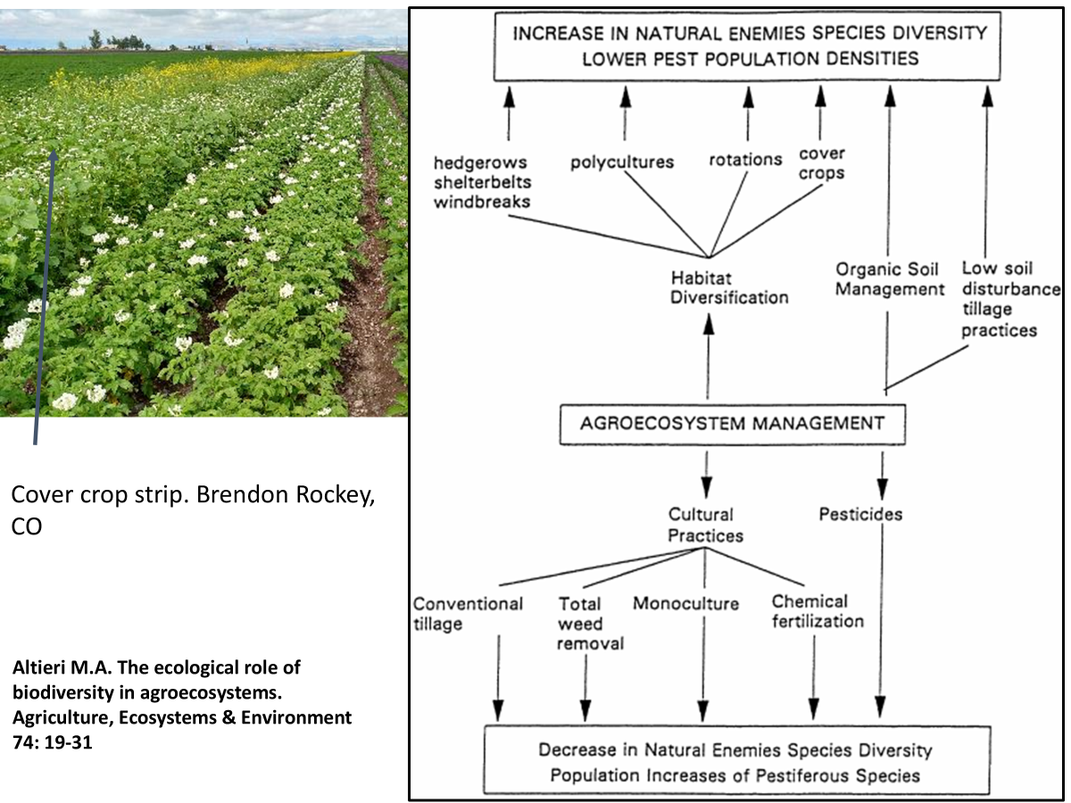
Ecological hypotheses that relate to agricultural management
Diversity-invisibility hypothesis
Suggests that diverse communities may be more difficult to invade because all of the ecosystem niches would be filled, and resources would be utilized.
What practices could we implement?
Notes:
Brandon Rockey has followed the advise of DR. Altieri, Learning a new management style to increase natural enemies and lower pest pressure
What practices could we use? 329, 345, 340, 595, 590, 336, 328, 422(hedgerow planting), 449, 612(tree and shrub planting)

Slide 21
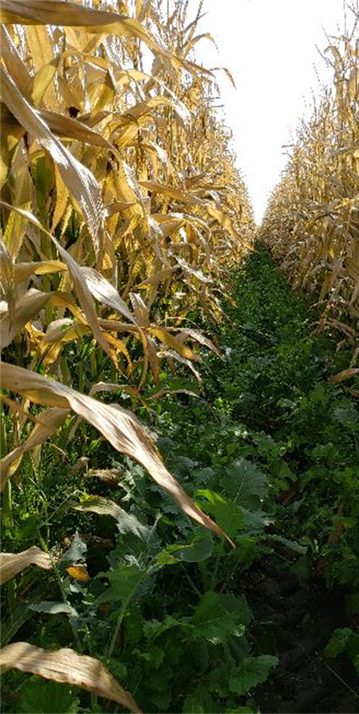
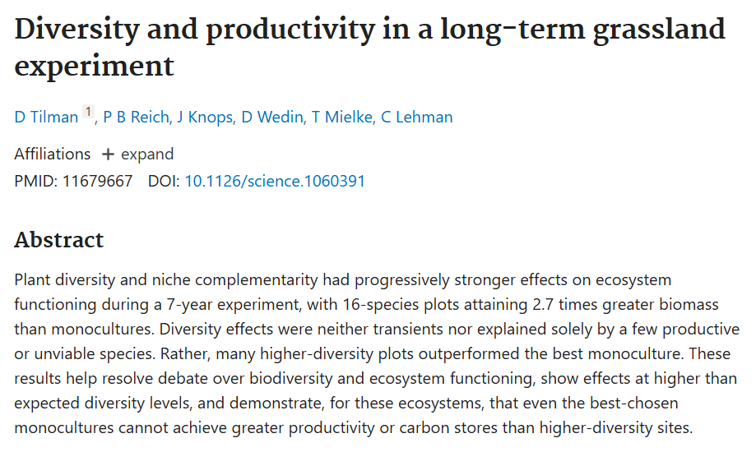
Theory of Cover Crop Diversity
Improved Establishment
More efficient resource use
Improved pest resistance
Increased cover crop biomass
Increased Ecosystem Services
Notes:
Cover crop planted in corn silage, mix, ryegrass, turnip, radish, clover, H. vetch

Slide 22
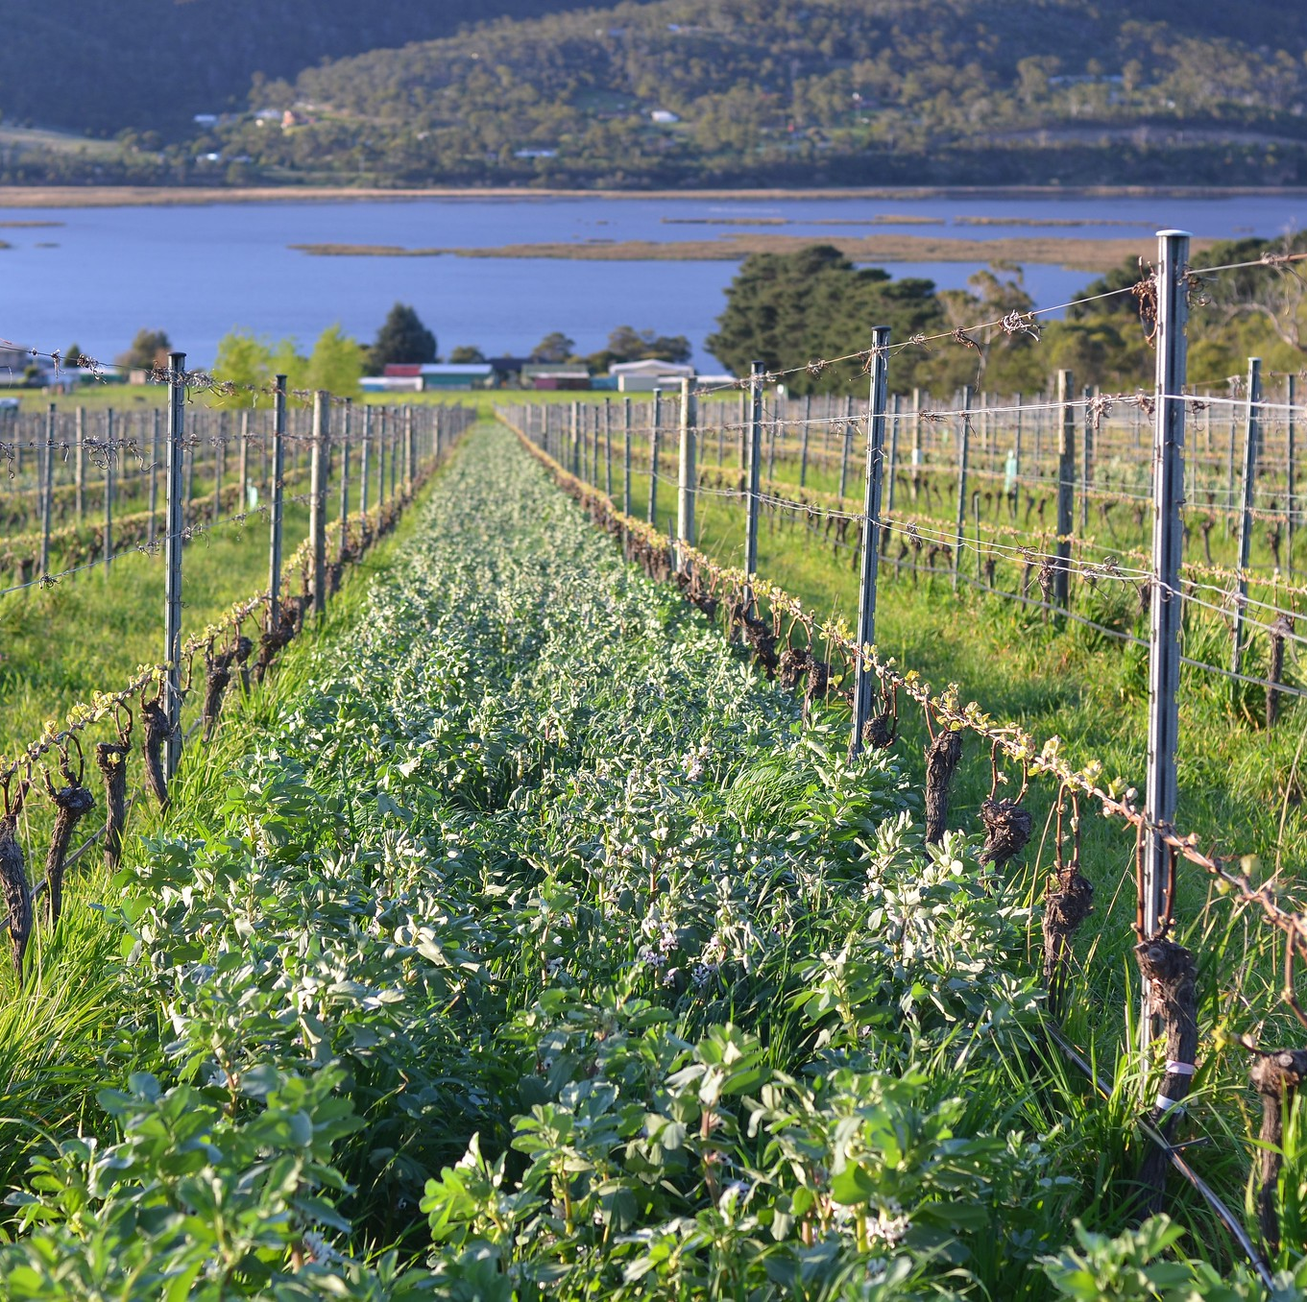
Cover Crop Functional Groups
"Cover cropping at Granton Vineyard (fava beans)" by stefano lubiana wines is licensed under CC BY 2.0.

Slide 23
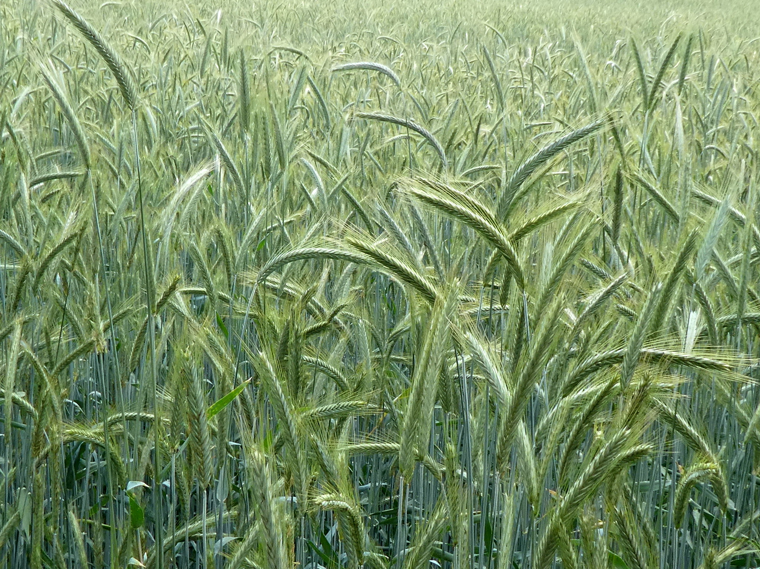
Warm and Cool Season Grasses
Benefits
Weed Suppression
Carbon Sequestration (cycling)
Prevent Erosion
Mitigate Nitrate Leaching
Low cost
Higher C:N ratio
Relieve shallow compaction
Challenges
Common in western rotations
Can immobilize N if mature - manage
"Cereal Rye" by muffinn is licensed under CC BY 2.0.
Notes:
Prevent erosion = a higher C:N ratio so it doesn’t decompose so fast, C or high residue is generally a good thing
Challenges: as a manager can you manage the cover crops C:N ratio? = maturity, carbon in the mix

Slide 24
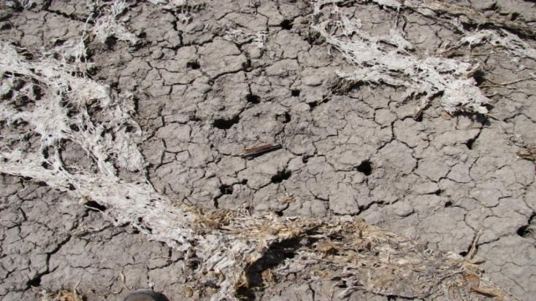
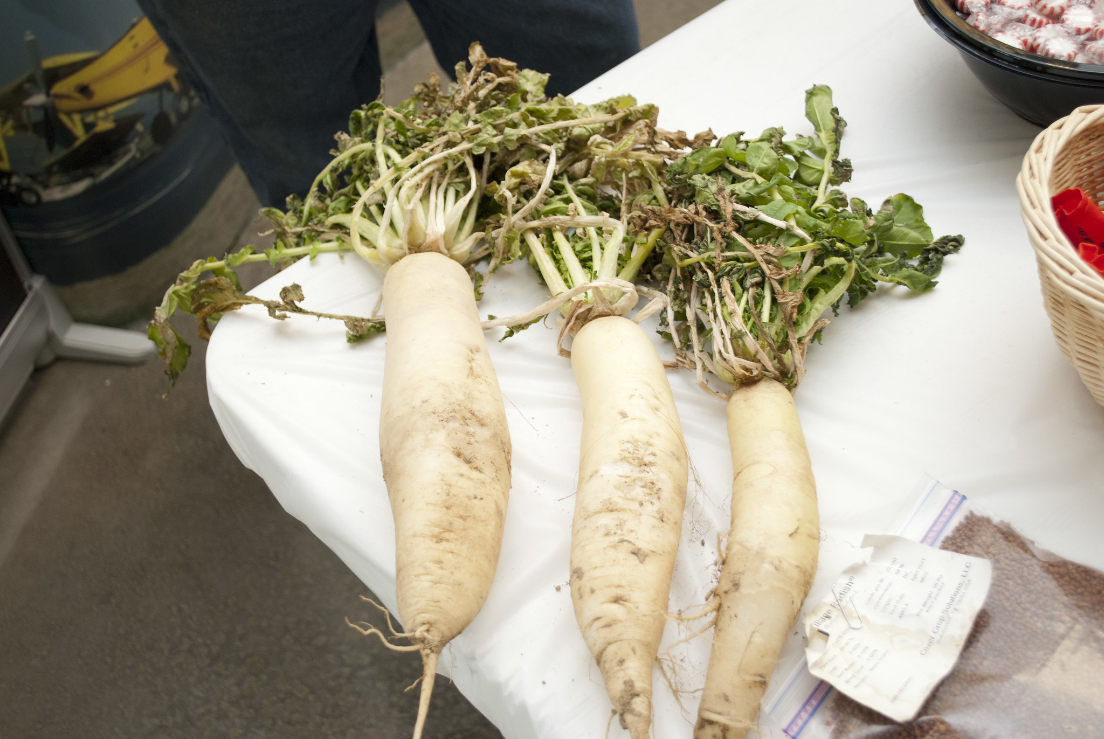
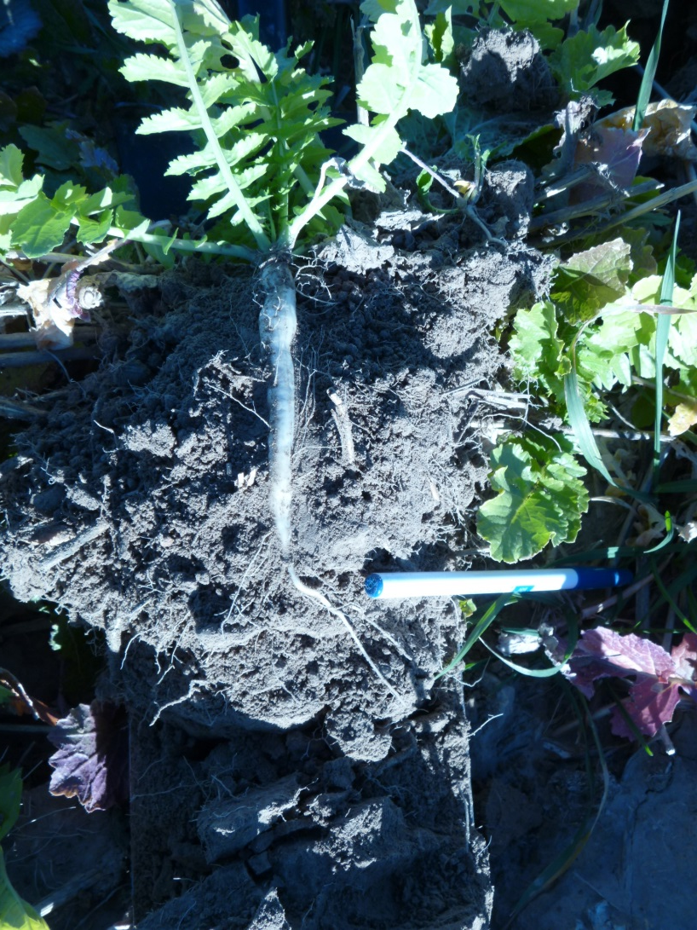
Cool and Warm Season Broadleaves
Benefits
Pollen and nectar source
Many can alleviate soil compaction (deep)
Scavenge soil nutrients (tap roots)
Legumes fix Nitrogen
Small seeded
Leaves large infiltration pores
Challenges
Expensive (legumes)
Some have lower germination rates
Lower C:N ratios
Brassica family can dominate a mix -manage
Notes:
Generally not expensive for brassicas and they establish sometimes to quickly and can dominate a cc mix if not planned correctly
Broadleaf species can be expensive if planted in monoculture, but in mixes at appropriate rates are good
Top pic shows large biopores left after a radish cover crop
Bottom pic shows a 4 inch tall radish but a 8 inch tap root breaking through a tillage pan

Slide 25
What does your state use to show the functional cover crop groups?
Notes:
How would you make 6 functional groups from this chart?
How would you make 2 functional groups?
How would you make 4 functional groups?

Slide 26

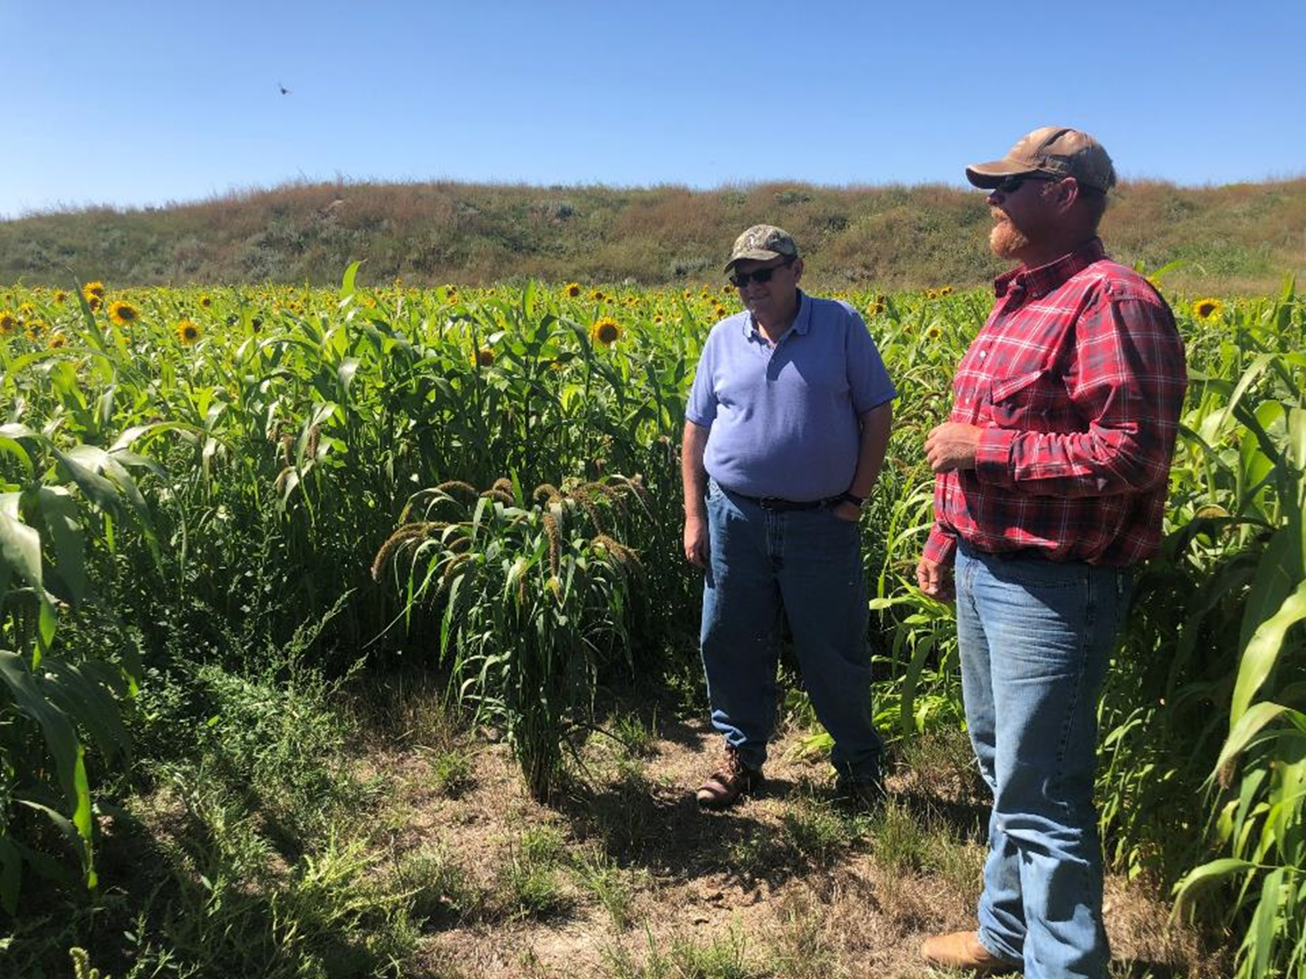
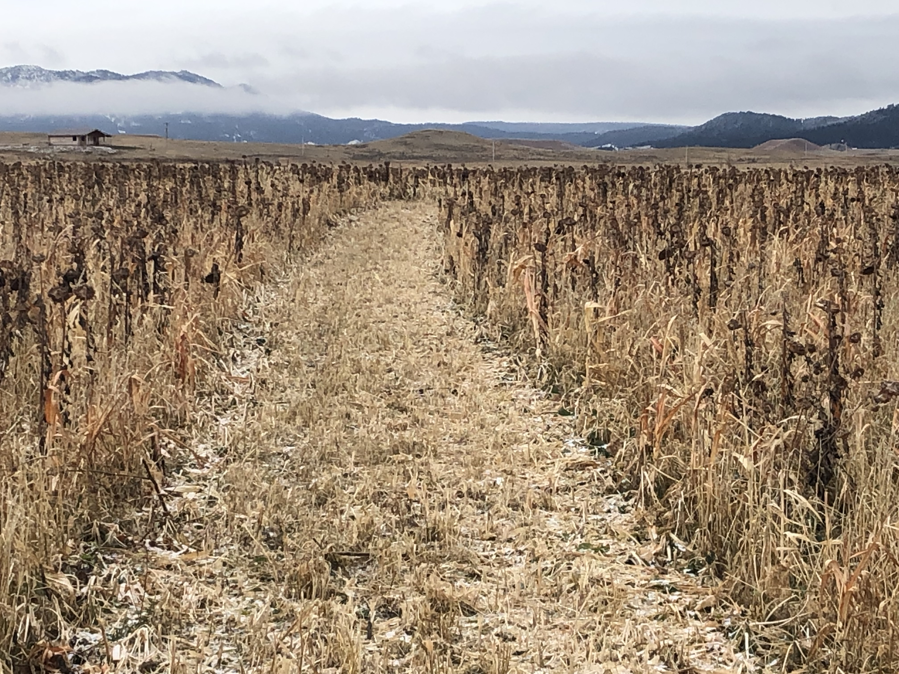
How to add diversity to agriculture and cover crop management
Identify producer goals / Resource Concerns
    You can address multiple goals with mixes.
Multifunction – build the “team” using key players from the functional groups.
18 way cc mix, WY
13 way cc mix, WY

Slide 27
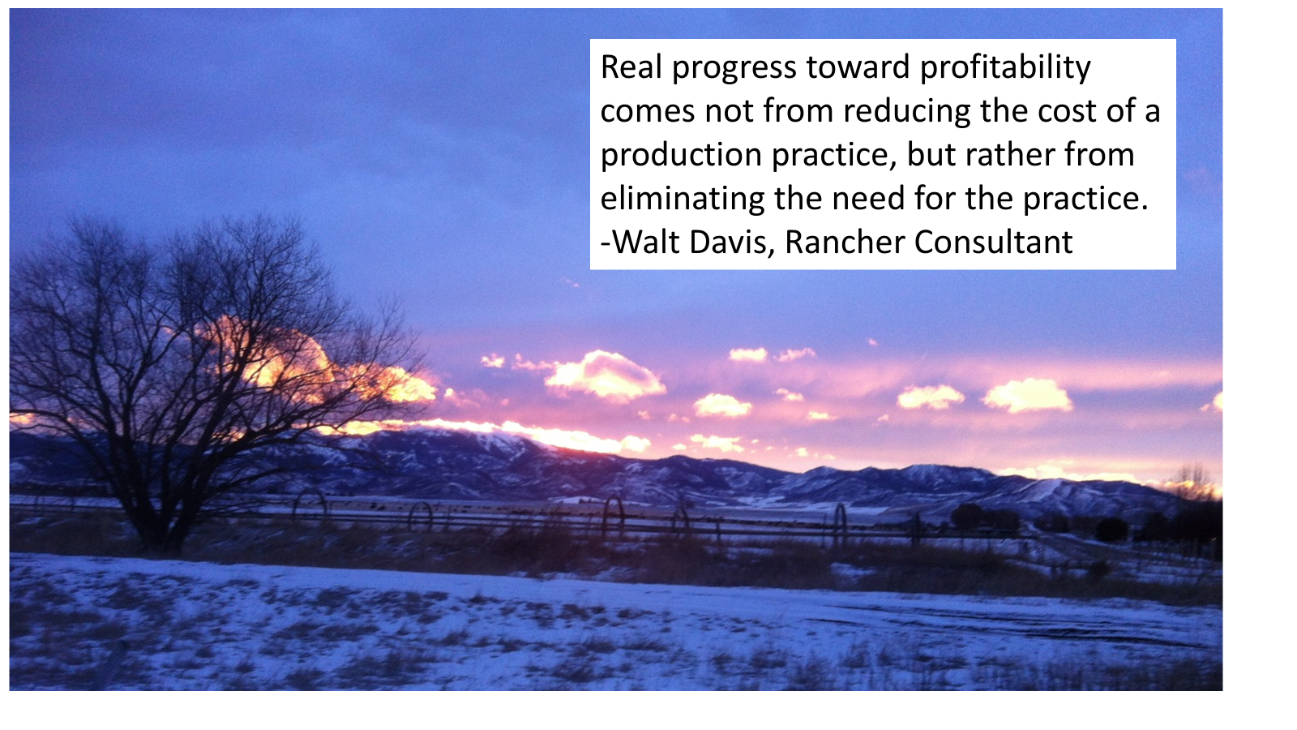
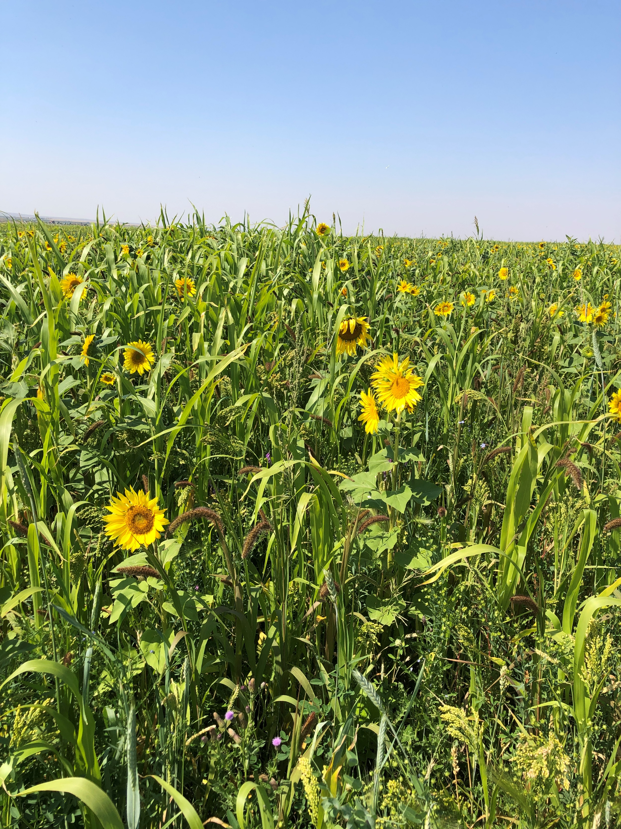
Notes:
Why do we need tree and shrub planting (windbreak) when we could use no till which leaves the ground covered.
Why do we feed cattle baled hay? when the could eat multi species cover crop in the winter
Why is our fertilizer bill so much? we could improve our ecosystem functions and plant more legumes
Why is our pest / disease problem so bad? to much monoculture cropping, low micro nutrient content in crops ect
Why is our water infiltration so low? Poor soil structure
Why are we loosing so much soil OM? Not following the principles of Soil Health

Slide 28
Thank you!
For more information on Managing Soil Health,
visit us here:
https://www.nrcs.usda.gov/conservation-basics/natural-resource-concerns/soils/soil-health
USDA is an equal opportunity provider, employer, and lender.

